Slide 1
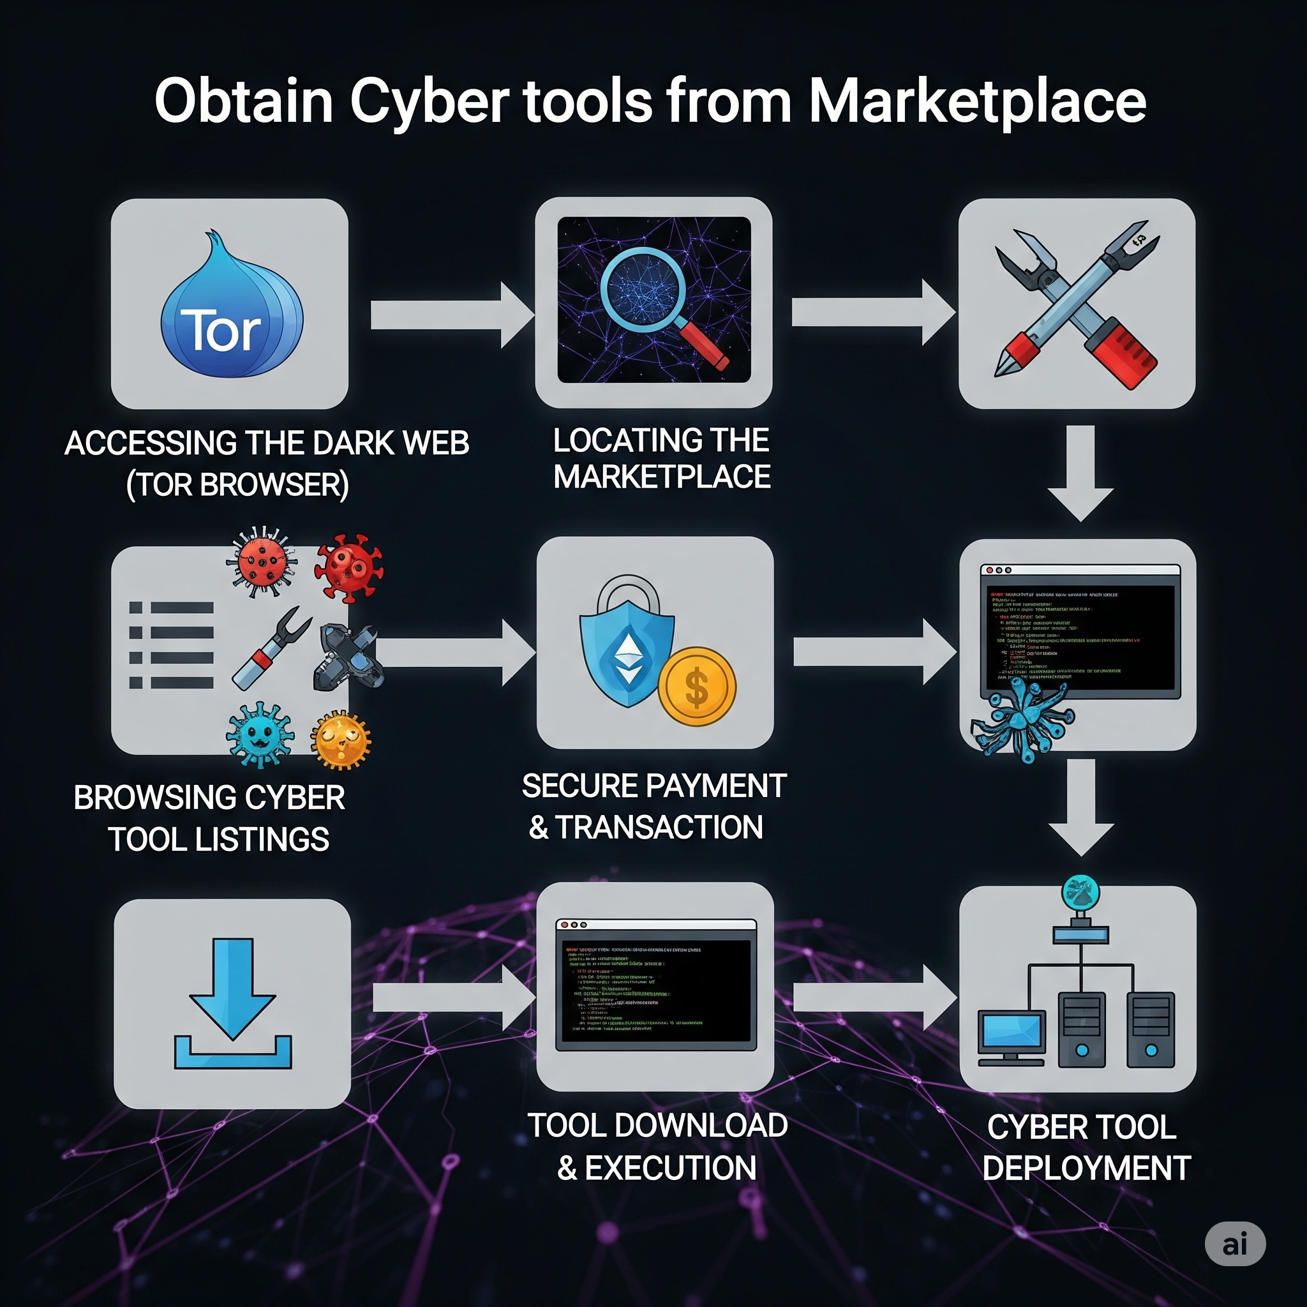
Dark Web Marketplaces For Cyber Tools
Andalib Rasdi. ID : 0242220005101353

Slide 2
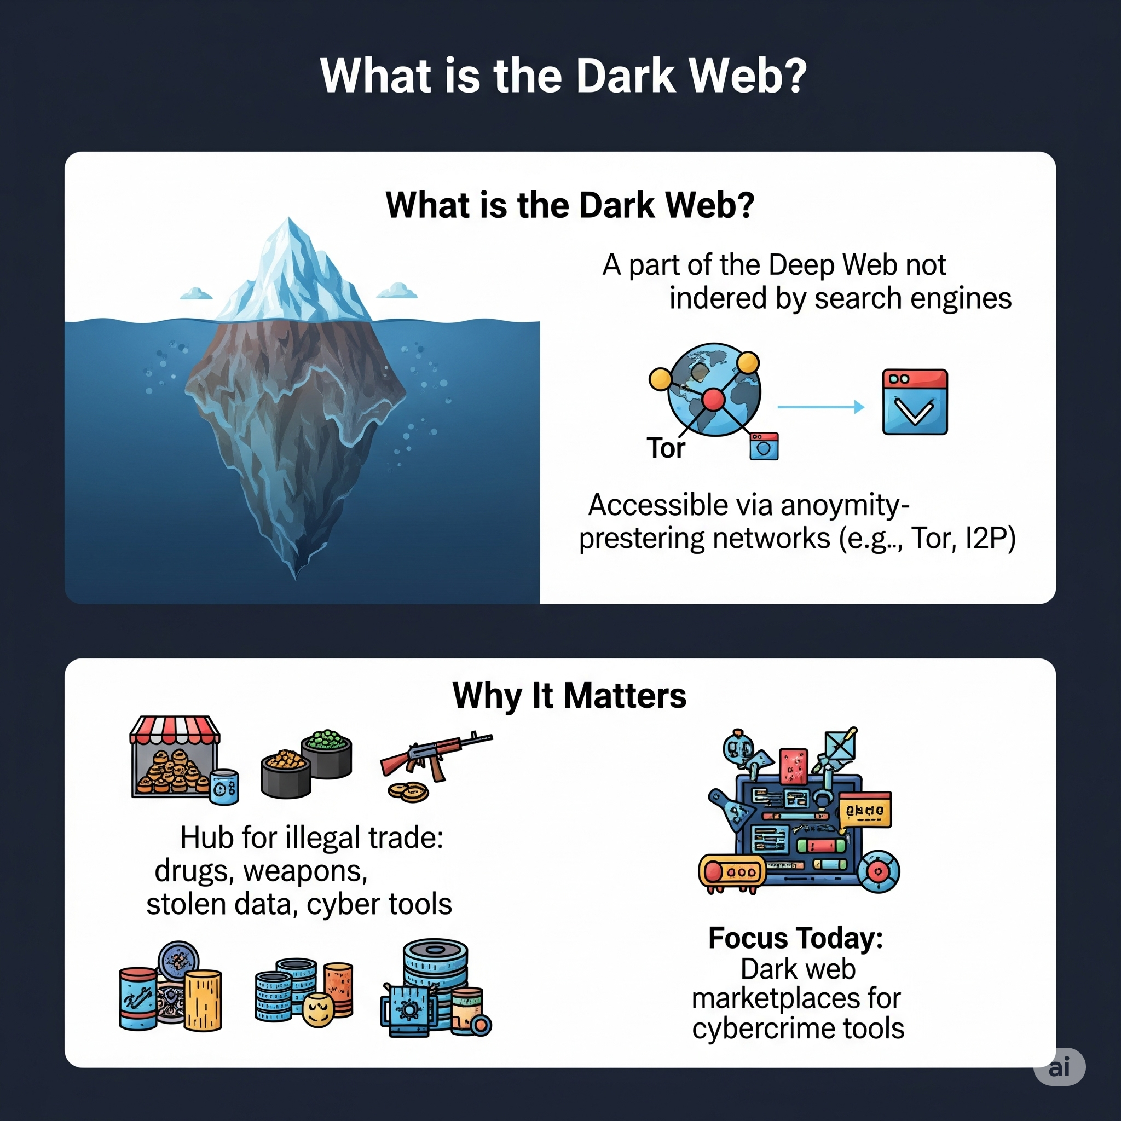
Introduction
What is the Dark Web?
A part of the Deep Web not indexed by search engines.
Accessible via anonymity-preserving networks.
Why It Matters
Hub for illegal trade: drugs, weapons, stolen data, cyber tools.
Focus Today: Dark web marketplaces for cybercrime tools.

Slide 3

Types of Cyber Tools Sold on the Dark Web
01
What’s for Sale in Dark Web Marketplaces?

Slide 4
Remote Access Trojans (RATs) – Allow full control over a victim’s machine.
Phishing Kits – Pre-built email templates & fake login pages.
Exploit Kits – Code that takes advantage of software vulnerabilities.
Crypters & Packers – Make malware undetectable.
DDoS Services – Rent a botnet to take down websites.
Credential Dumps – Stolen usernames and passwords.
Zero-Day Exploits – Unpatched, high-value vulnerabilities.

Slide 5
Major Marketplaces for Cyber Tools
Marketplace | Status | Specialty
AlphaBay | Shut down (2017) → Relaunched (2021) | Malware, services, credentials
Empire Market | Exit scam (2020) | Tools, accounts, drugs
RAMP | Active (Russian) | Exploits, ransomware
Genesis Market | Seized in 2023 | Digital identities
Exploit.in | Active | Vulnerabilities & hacking kits

Slide 6
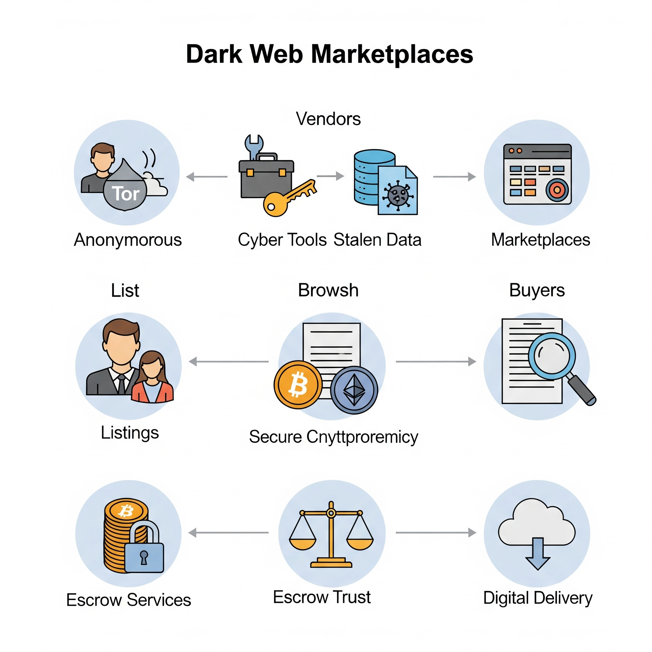
How These Marketplaces Operate
Accessed via Tor or I2P for anonymity.
Payment through cryptocurrencies like Monero (preferred for privacy).
Escrow systems protect both parties during transactions.
PGP encryption used for communication.
Vendor profiles with ratings, reviews, and digital “trust scores.”

Slide 7

Cyber Tools Offered
02
Real Listings of Cyber Tools

Slide 8
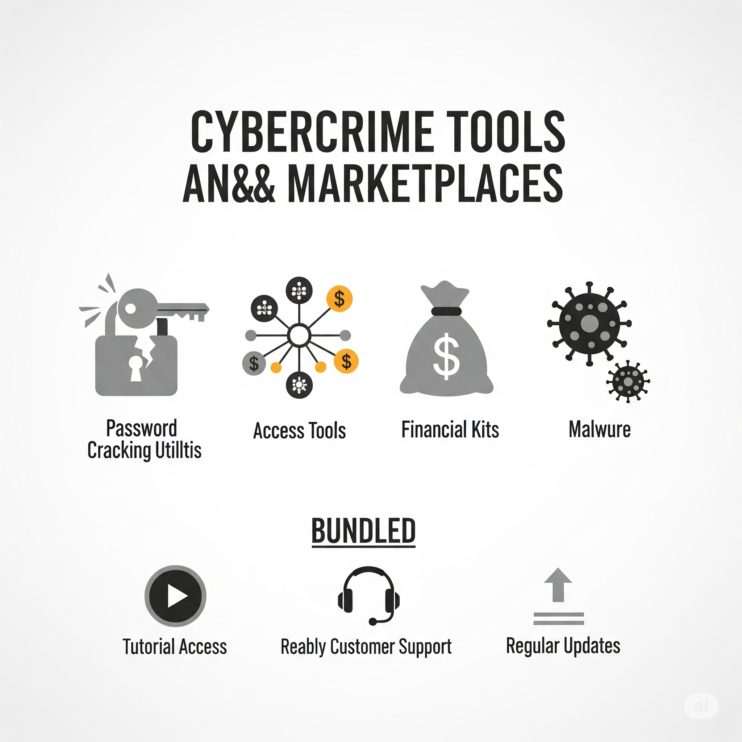
Types of Cyber Tools
“FUD Crypter – 100% undetectable by AV – $120”
“RDP access to U.S. hospitals – $300 per server”
“Bank phishing kit + email list – $80”
“Cobalt Strike cracked edition – $250”
“Full malware deployment package (ransomware + builder) – $500”
Often bundled with:
Video tutorials
24/7 customer support (!)
Free updates

Slide 9
Cyber Tool Buyers: From Hackers to Governments
Script Kiddies – Low-skill users running pre-made tools.
Cybercriminal Gangs – Use tools for data theft, fraud, ransomware.
Hacktivists – Politically motivated attacks.
Nation-State Actors – Espionage, sabotage, surveillance.
Insiders – Employees selling or deploying tools internally.
Motivations:
Financial gain
Disruption
Espionage
Revenge

Slide 10
Detection & Prevention Strategies
Dark Web Monitoring: Track if credentials are sold online.
Threat Intelligence Feeds: Alerts on new tools and TTPs (tactics, techniques, procedures).
User Awareness Training: Prevent phishing & insider threats.
Endpoint Detection & Response (EDR): Identify tool behaviors.
Patch Management: Prevent exploitation of known vulnerabilities.
Zero Trust Architecture: Trust no device or user by default.

Slide 11

Conclusions
Dark web marketplaces have made powerful hacking tools easily accessible to anyone, fueling the rapid growth of the cybercrime economy. While law enforcement continues to take down these platforms, new ones constantly emerge, making the threat hard to contain. Staying protected requires constant vigilance, awareness, and global cooperation.

Slide 12
Thank you!
Do you have any questions?
404 Not Found

